Slide 2
In the time of the prophet Isaiah, Isaiah
IMAGINED
a messiah who would comfort those who mourn, and bind up the brokenhearted.

Slide 3
In 2008, parents lost children from malaria every 30 seconds. But we
IMAGINED
joy instead of mourning and now
that number is cut in half!

Slide 5
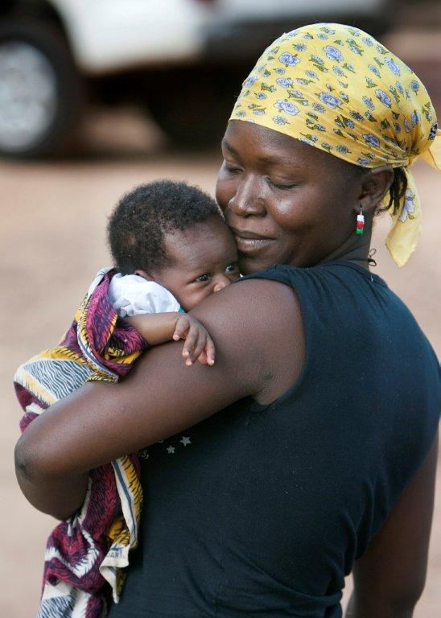
Over 2000 years ago, a young mother
IMAGINED
what life would be like for her young son.

Slide 6
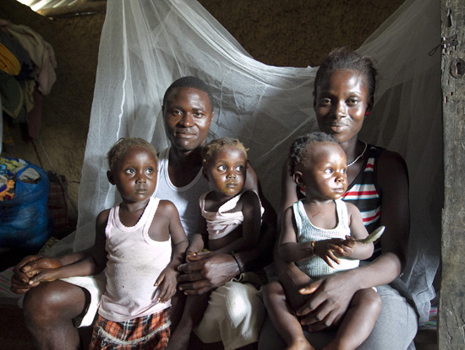
United Methodists
IMAGINED
life for children in Africa without the threat of malaria, and distributed over 1.2 million nets to African families.

Slide 7
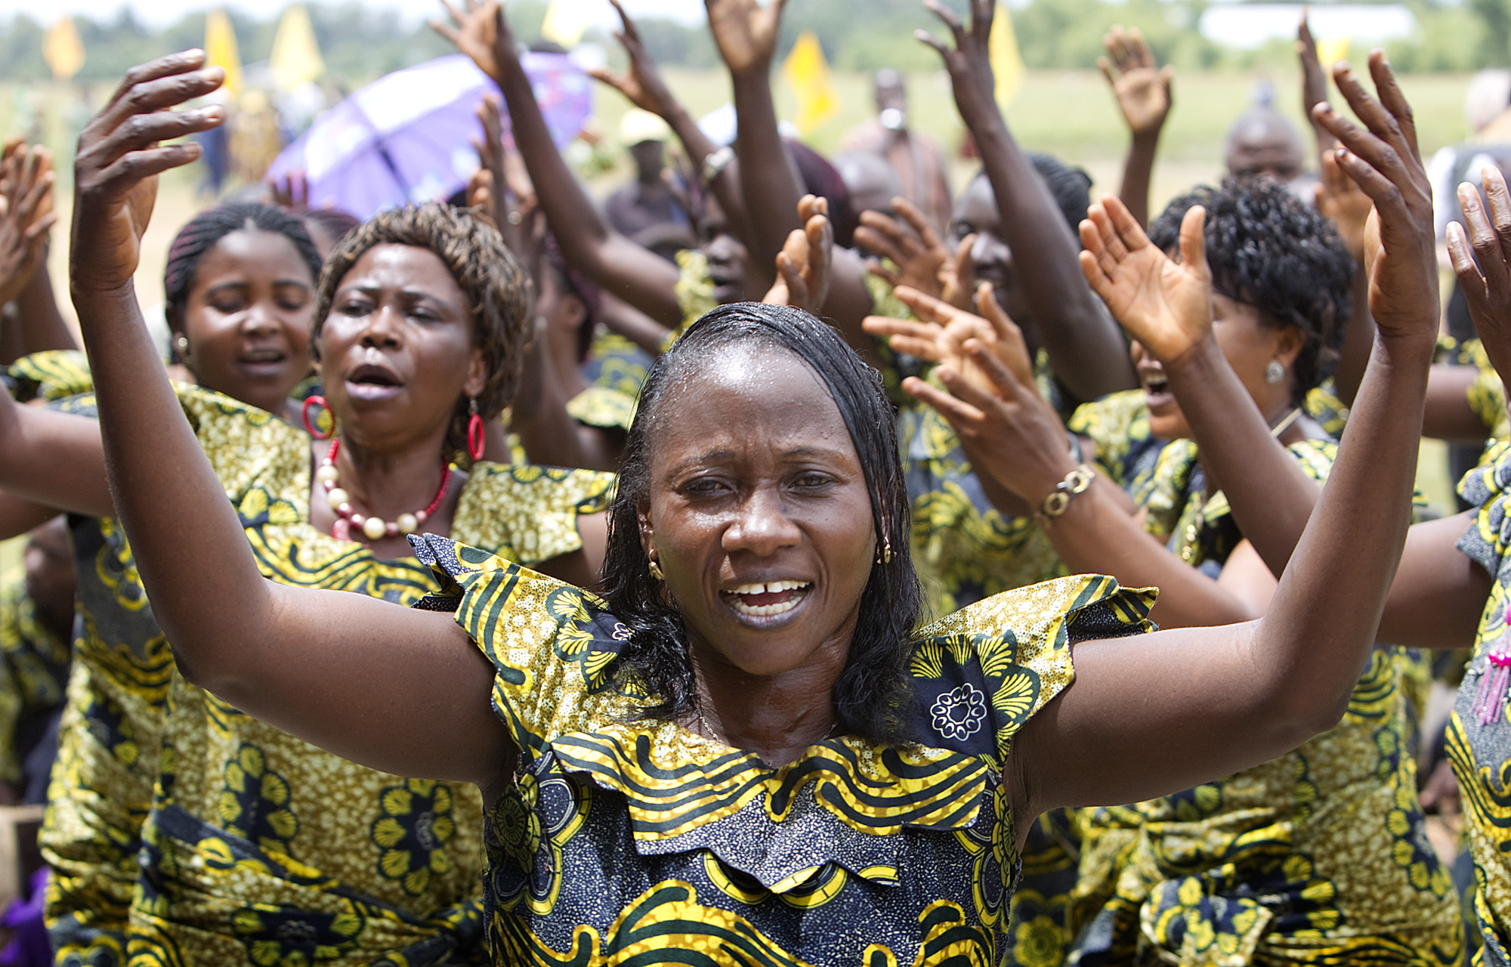
When the Christ Child was still a baby, Simeon
IMAGINED
the salvation of the world through Jesus.

Slide 8
The people of the United Methodist Church
IMAGINED
distributing nets to every family in Sierra Leone. In addition to saving thousands of lives, the UMC was asked by village leaders to build six new churches in a predominantly Muslim area of Sierra Leone.

Slide 9
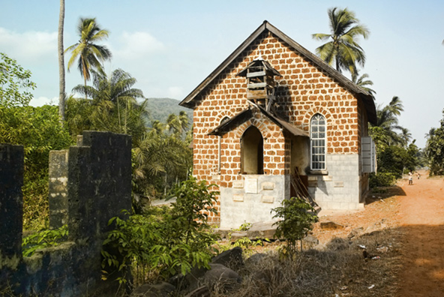
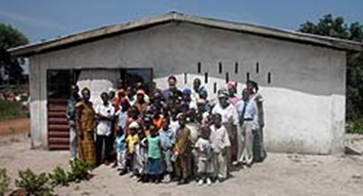
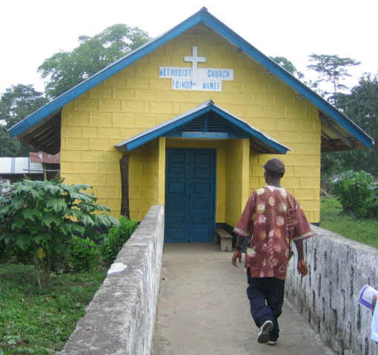
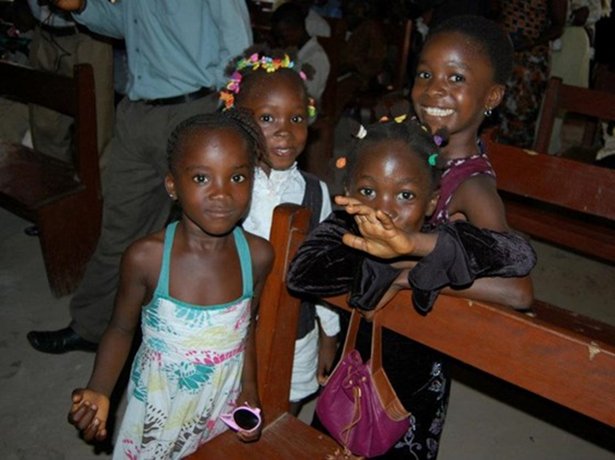
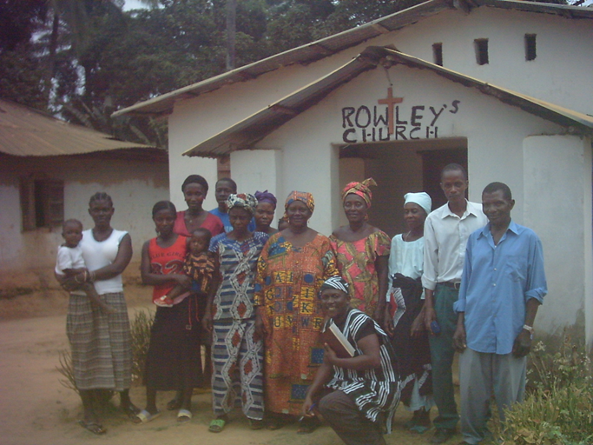

Slide 10
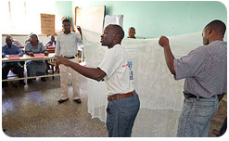
IMAGINE …
Over 5,400 local community volunteers trained.

Slide 11
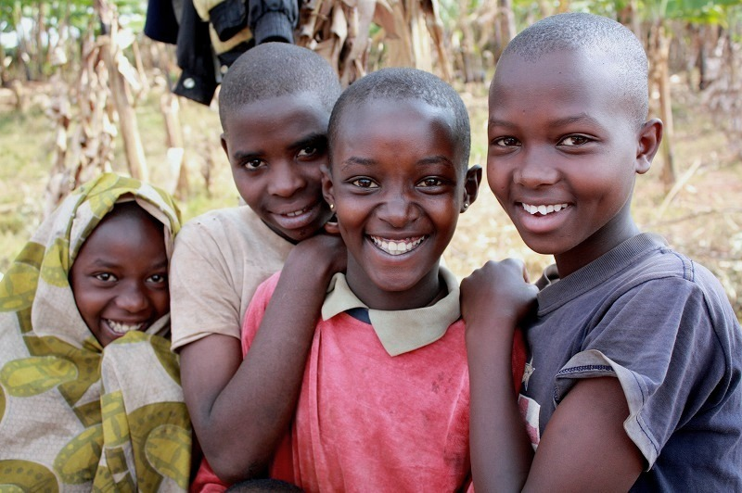
IMAGINE …
A world where every child lived past the age of 5.

Slide 12
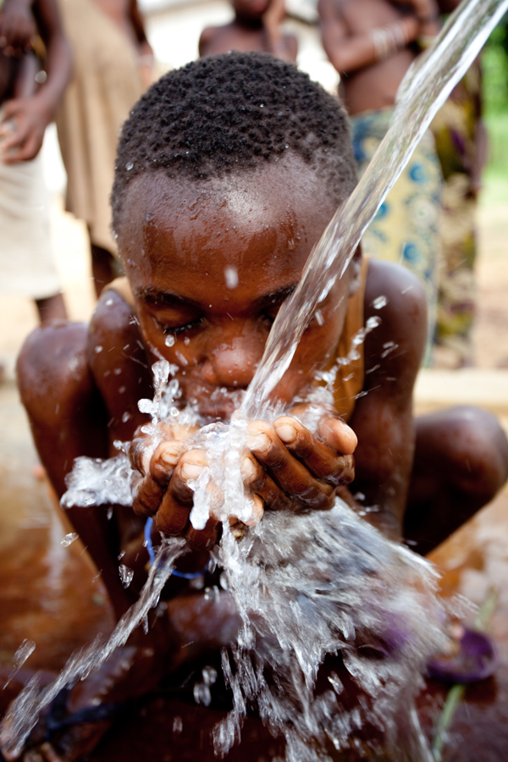
IMAGINE …
Pools of stagnate mosquito breeding water
being drained and access to clean water.

Slide 13
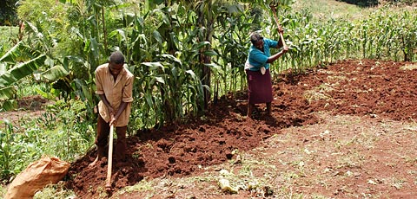
IMAGINE …
The economy improving 1.3% every year because farmers are healthy enough to harvest their crops.

Slide 14
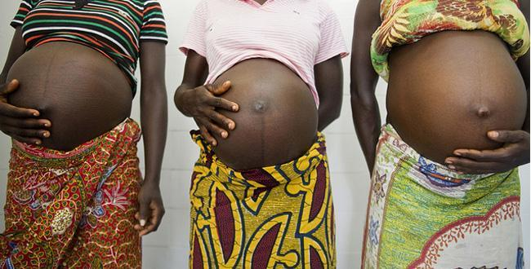
IMAGINE …
Pregnant women living to see their children grow up and their babies born healthy.

Slide 15
TODAY, what will you
IMAGINE?
One child forever changed our world. Will you change a child’s life forever?
Will you Imagine No Malaria?

Slide 16
For more information, or to donate online go to www.bwcumc.org/ImagineNoMalaria

